Slide 1
Distributed mutual exclusion
Distributed processes often need to coordinate their activities. I
f a collection of processes share a resource or collection of resources, then often mutual exclusion is required to prevent interference and ensure consistency when accessing the resources.
This is the critical section problem, familiar in the domain of operating systems.
In a distributed system, however, neither shared variables nor facilities supplied by a single local kernel can be used to solve it, in general.
We require a solution to distributed mutual exclusion: one that is based solely on message passing.

Slide 2
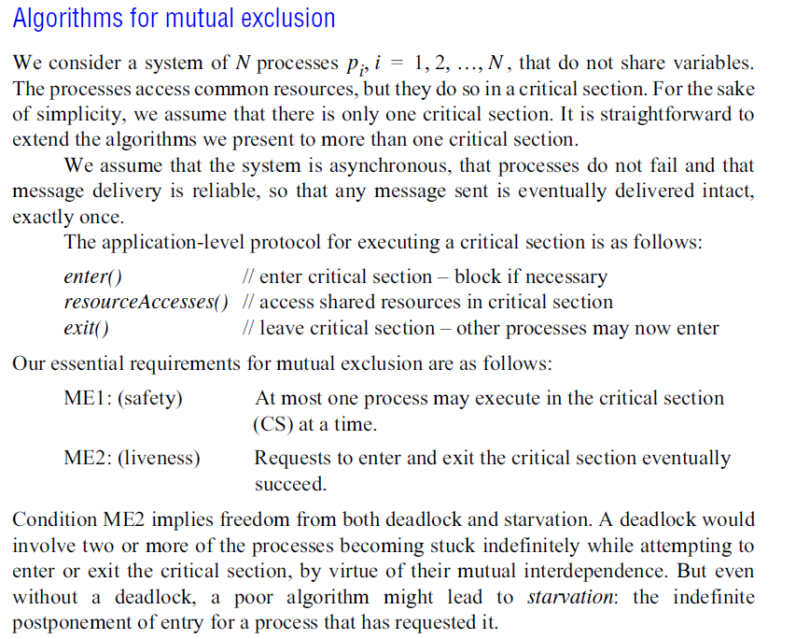

Slide 3
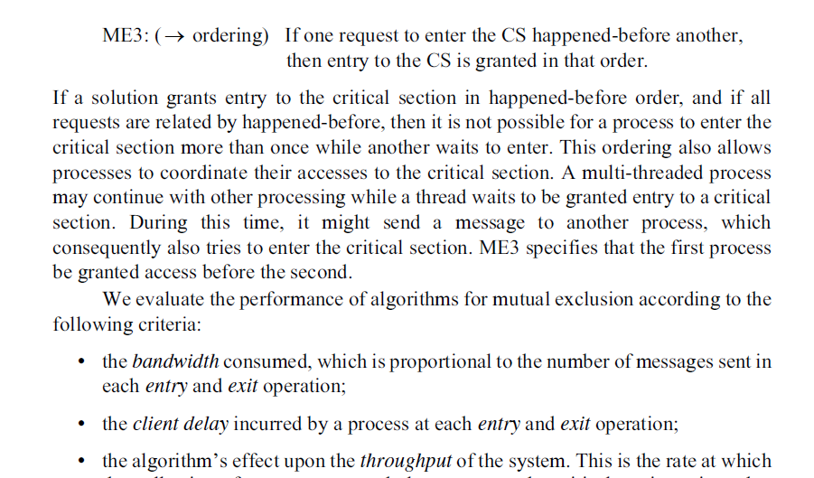

Slide 4
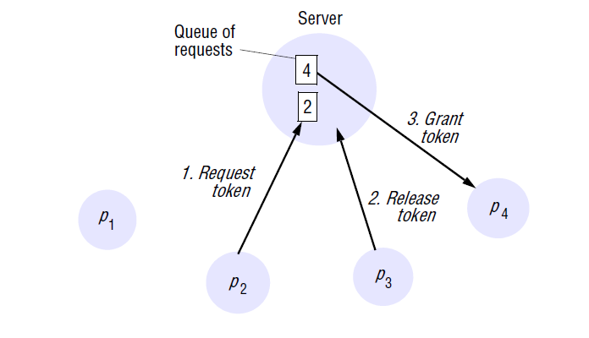
The central server algorithm •
The simplest way to achieve mutual exclusion is to employ a server that grants permission to enter the critical section.
Figure 15.2 shows the use of this server. To enter a critical section, a process sends a request message to the server and awaits a reply from it. Conceptually, the reply constitutes a token
signifying permission to enter the critical section. If no other process has the token at the time of the request, then the server replies immediately, granting the token. If the token is currently held by another process, then the server does not reply, but queues the request. When a process exits the critical section, it sends a message to the server, giving it back the token.

Slide 5
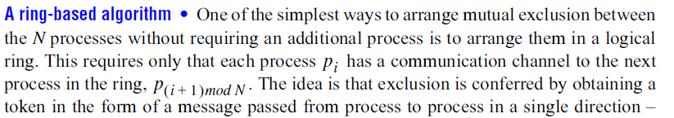
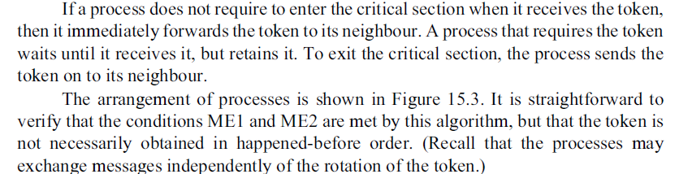
The server may become a performance bottleneck for the system as a whole.
The synchronization delay is the time taken for a round-trip: a release message to the server, followed by a grant message to the next process to enter the critical section

Slide 6
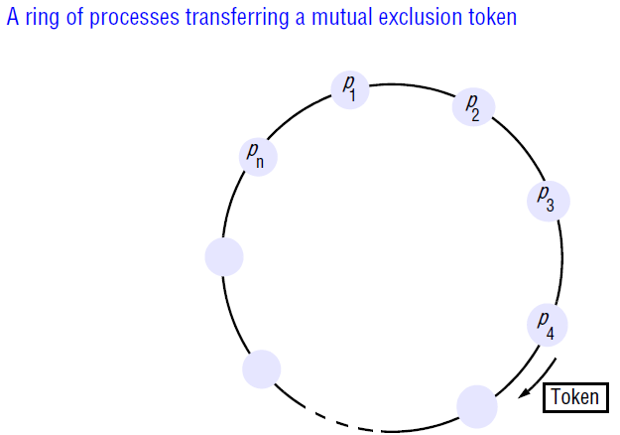
This algorithm continuously consumes network bandwidth (except when a process is inside the critical section): the processes send messages around the ring even when no process requires entry to the critical section. The delay experienced by a process requesting entry to the critical section is between 0 messages (when it has just received the token) and N messages (when it has just passed on the token).

Slide 7
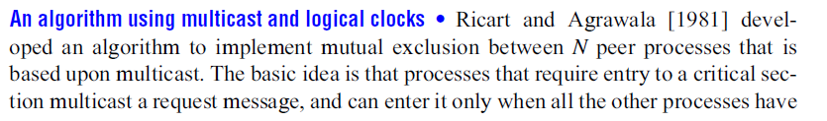
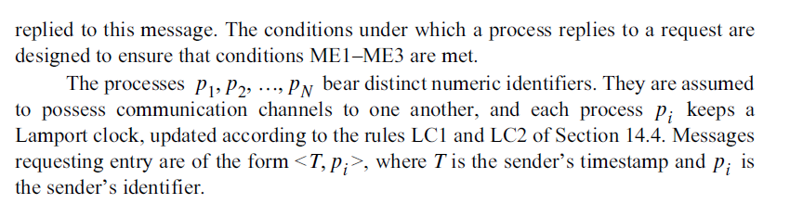
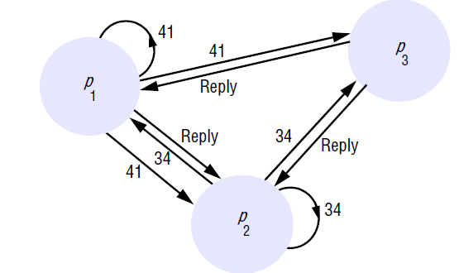

Slide 8
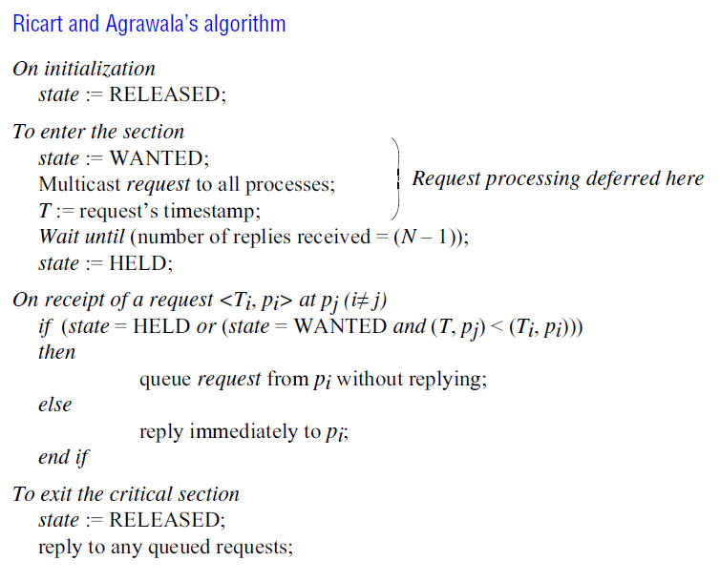

Slide 9
Each process records its state of being outside the critical section (RELEASED), wanting entry (WANTED) or being in the critical section (HELD) in a variable state. The protocol is given in Figure 15.4.
If a process requests entry and the state of all other processes is RELEASED, then all processes will reply immediately to the request and the requester will obtain entry. If some process is in the state HELD, then that process will not reply to requests until it has finished with the critical section, and so the requester cannot gain entry in the meantime.
If two or more processes request entry at the same time, then whichever process’s request bears the lowest timestamp will be the first to collect N – 1 replies, granting it entry next.
The advantage of this algorithm is that its synchronization delay is only one message transmission time. Both the previous algorithms incurred a round-trip synchronization delay.

Slide 10
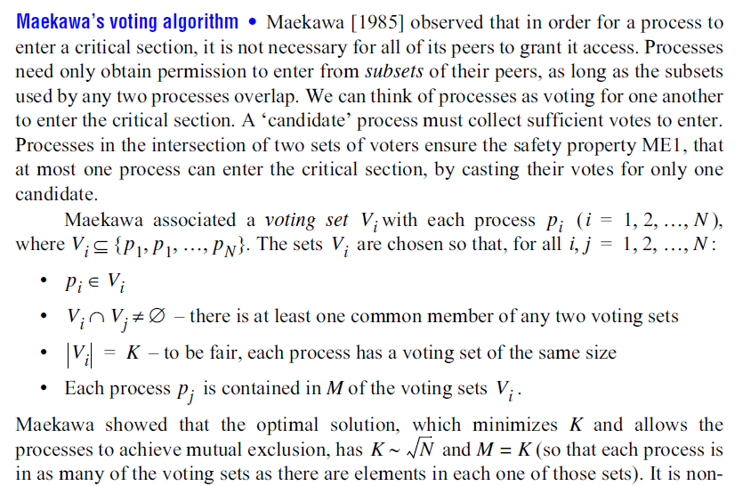

Slide 11
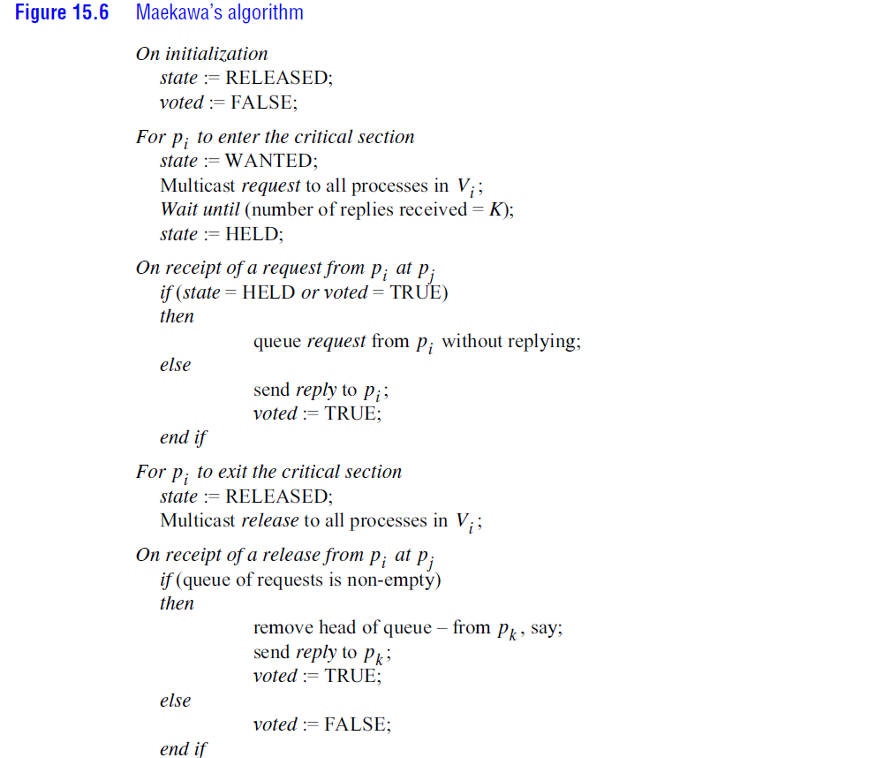

Slide 12
Fault tolerance • The main points to consider when evaluating the above algorithms
with respect to fault tolerance are:
• What happens when messages are lost?
• What happens when a process crashes?
None of the algorithms that we have described would tolerate the loss of messages, if the channels were unreliable.
The ring-based algorithm cannot tolerate a crash failure of any single process.
As it stands, Maekawa’s algorithm can tolerate some process crash failures: if a crashed process is not in a voting set that is required, then its failure will not affect the other processes.
The central server algorithm can tolerate the crash failure of a client process that neither holds nor has requested the token.
The Ricart and Agrawala algorithm as we have described it can be adapted to tolerate the crash failure of such a process, by taking it to grant all requests implicitly.

Slide 13
15.4 In the central server algorithm for mutual exclusion, describe a situation in which two requests are not processed in happened-before order.
15.4 Ans. Process A sends a request Ra for entry then sends a message m to B. On receipt of m, B sends request Rb for entry. To satisfy happened-before order, Ra should be granted before Rb. However, due to the vagaries of message propagation delay, Rb arrives at the server before Ra, and they are serviced in the opposite order.
15.5 Adapt the central server algorithm for mutual exclusion to handle the crash failure of any client (in any state), assuming that the server is correct and given a reliable failure detector. Comment on whether the resultant system is fault-tolerant. What would happen if a client that possesses the token is wrongly suspected to have failed?

Slide 14
11.5 Ans. The server uses the reliable failure detector to determine whether any client has crashed. If the client has been granted the token then the server acts as if the client had returned the token.
In case it subsequently receives the token from the client (which may have sent it before crashing), it ignores it. The resultant system is not fault-tolerant.
If a token-holding client crashed then the application-specific data protected by the critical section (whose consistency is at stake) may be in an unknown state at the point when another client starts to access it.
If a client that possesses the token is wrongly suspected to have failed then there is a danger that two processes will be allowed to execute in the critical section concurrently.

Slide 15
15.7 In a certain system, each process typically uses a critical section many times before another process requires it. Explain why Ricart and Agrawala’s multicast-based mutual exclusion algorithm is inefficient for this case, and describe how to improve its performance. Does your adaptation satisfy liveness condition ME2?
15.7 Ans: In Ricart and Agrawala’s multicast-based mutual exclusion algorithm, a client issues a multicast request every time it requires entry. This is inefficient in the case described, of a client that repeatedly enters the critical section before another needs entry. Instead, a client that finishes with a critical section and which has received no outstanding requests could mark the token as JUST_RELEASED, meaning that it has not conveyed any information to other processes that it has finished with the critical section.
If the client attempts to enter the critical section and finds the token to be JUST_RELEASED, it can change the state to HELD and re-enter the critical section.
To meet liveness condition ME2, a JUST_RELEASED token should become RELEASED if a request for entry is received.

Slide 16
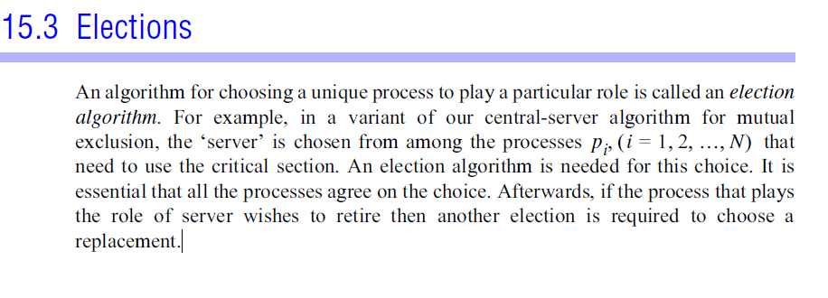
Give an example execution of the ring-based algorithm to show that processes are not necessarily granted entry to the critical section in happened-before order.
Ans: The token may be grabbed by B first then A. However, A happens before B.

Slide 17
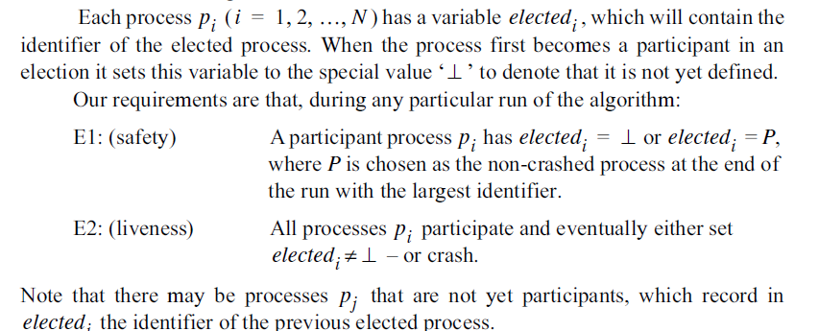

Slide 18
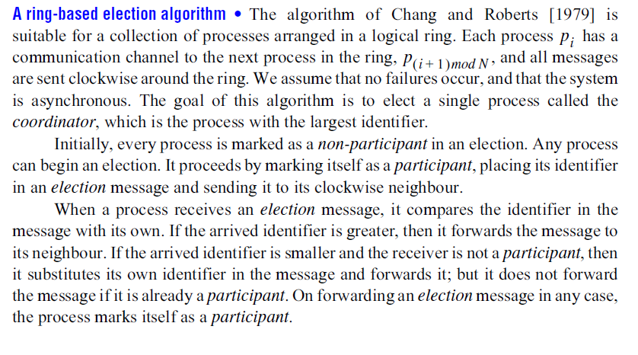

Slide 19
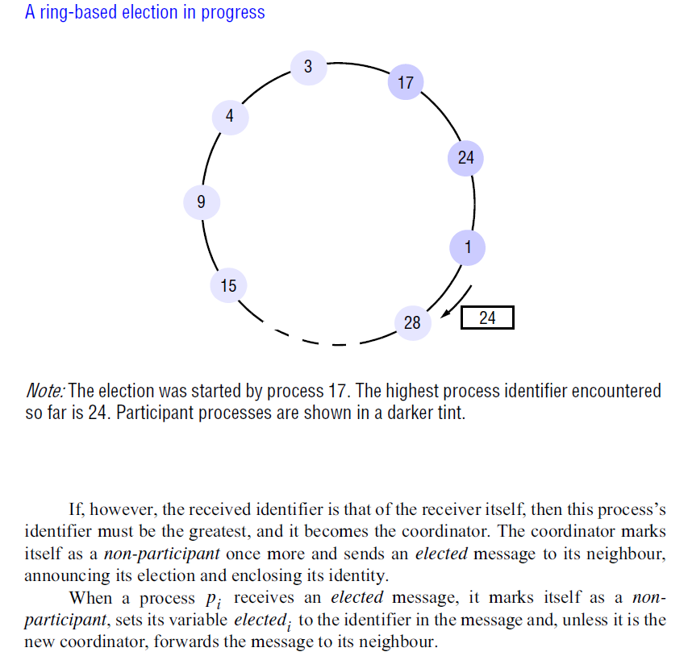

Slide 20
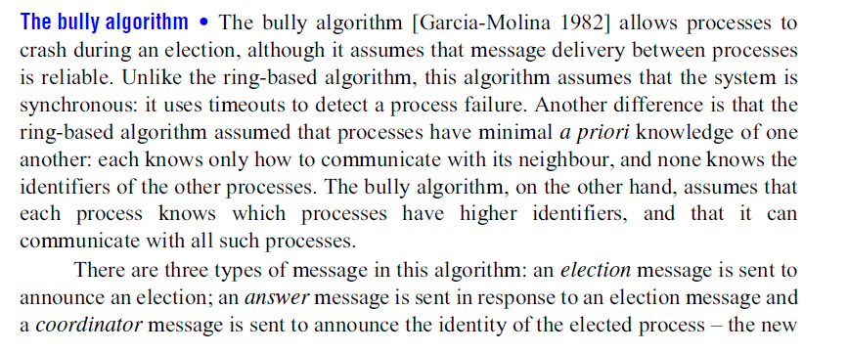

Slide 21
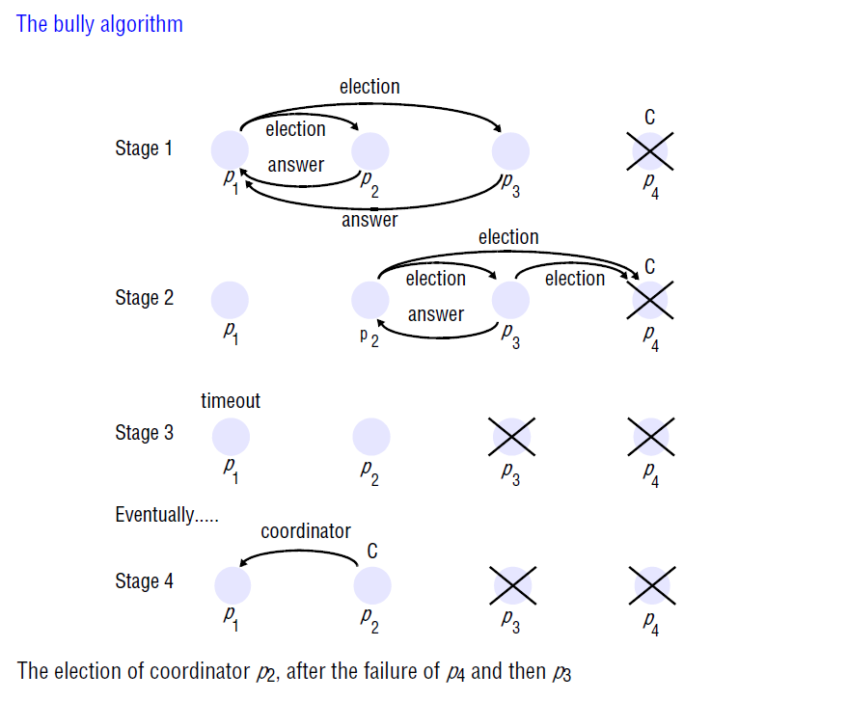

Slide 22
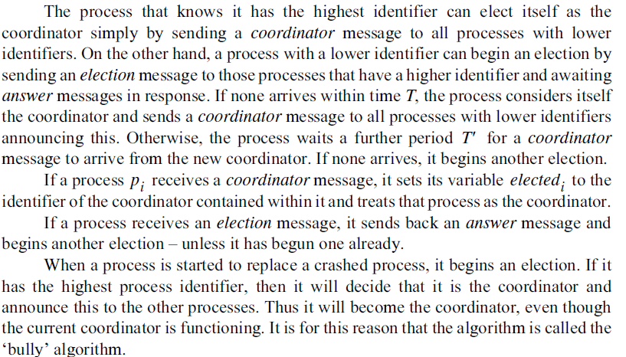

Slide 23
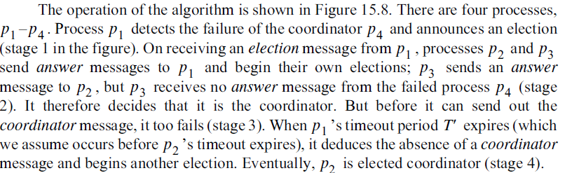

Slide 24
